Slide 1
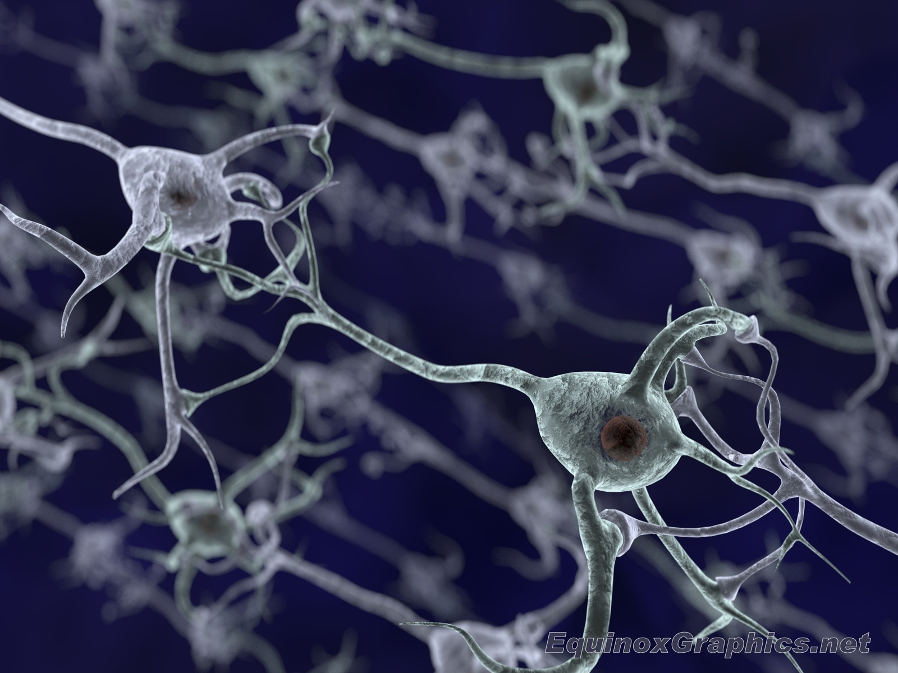
Neural Network Training Using MATLAB
Phuong Ngo
School of Mechanical Engineering
Purdue University

Slide 2
Neural Network Toolbox
Available Models in MATLAB:
Feedforward Neural Networks
Adaptive Neural Network Filters
Perceptron Neural Networks
Radial Basis Neural Networks
Probabilistic Neural Networks
Generalized Regression Neural Networks
Learning Vector Quantization (LVQ) Neural Networks
Linear Neural Networks
Hopfield Neural Network

Slide 3
Feedforward Neural Network
trainlm | Levenberg-Marquardt
trainbr | Bayesian Regularization
trainbfg | BFGS Quasi-Newton
trainrp | Resilient Backpropagation
trainscg | Scaled Conjugate Gradient
traincgb | Conjugate Gradient with Powell/Beale Restarts
traincgf | Fletcher-Powell Conjugate Gradient
traincgp | Polak-Ribiére Conjugate Gradient
trainoss | One Step Secant
traingdx | Variable Learning Rate Gradient Descent
traingdm | Gradient Descent with Momentum
traingd | Gradient Descent

Slide 4
Radial Basis Function Network
Exact Design (newrbe)
This function can produce a network with zero error on training vectors. It is called in the following way:
net = newrbe(P,T,SPREAD)
More Efficient Design (newrb)
The function newrb iteratively creates a radial basis network one neuron at a time. Neurons are added to the network until the sum-squared error falls beneath an error goal or a maximum number of neurons has been reached. The call for this function is
net = newrb(P,T,GOAL,SPREAD)

Slide 5
Fuzzy Basis Function Network (Not included in Neural Network Toolbox)
Backpropagation Algorithm
Adaptive Least Square with Genetic Algorithm

Slide 6
Training Steps
Generate training and checking data
Select the structure of the neural network
Perform the training
Verify the error with checking data

Slide 7
Examples

Slide 8
MATLAB Code (GenerateTrainingData)
function [x,Cx,d,Cd]=GenerateTrainingData(n,m,range)
% n - number of training samples
% m - number of checking samples
% range - zx2 range of input (z is the number of inputs)
% x - zxn matrix of training inputs
% Cx - zxm matrix of checking inputs
% d - 1xn matrix of training outputs
% Cd - 1xm matrix of checking outputs
if nargin < 3, error('Not enough input arguments'),end
[z,~] = size(range); % Obtain the number of system input
x = zeros(z,n);
Cx = zeros(z,m);
for i = 1:z
x(i,:) = (range(i,2)-range(i,1))*rand(1,n)+range(i,1)*ones(1,n); % Generate random training inputs
Cx(i,:) = (range(i,2)-range(i,1))*rand(1,m)+range(i,1)*ones(1,m); % Generate random checking inputs
end
d = zeros(1,n); % Define matrix d as an array of training outputs
for i = 1:n
d(i) = NonlinearFunction(x(:,i)); % Calculate d matrix
end
Cd = zeros(1,m); % Define matrix Cd as an array of checking outputs
for i = 1:m
Cd(i) = NonlinearFunction(Cx(:,i)); % Calculate Cd matrix
end
save('TrainingData.mat') % Save training data into file

Slide 9
MATLAB Code (Main Program)
addpath('./FBFN'); % add FBFN library
n = 900; % Define n as the number of training samples
m = 841; % Define m as the number of checking samples
InputRange = [-3 3; -3 3]; % Range of Input Signal
[x,Cx,d,Cd]=GenerateTrainingData(n,m,InputRange);
DP = [25,0,0]; % Specify the maxnimum number of fuzzy rules
warning('off');
[m_matrix,sigma_matrix,temp_w,NR,NDEI,CR] = adnfbf2(x,d,Cx,Cd,DP);
save('FBFN.mat')
plot(1:length(NDEI),NDEI)
xlabel('Number of Fuzzy Rules');
ylabel('NDEI');

Slide 10
adnfbf2.m
% [fismat,NR,TR,CR] = ADNEWFBF(x,d,Cx,Cd,DP)
% x - nxN matrix of N input vectors.
% d - 1xN vector of N target outputs
% Cx - nxCN matrix of CN input vectors for checking.
% Cd - 1xCN vector of CN target outputs
% DP - Design parameters (optional).
% Returns:
% m_matrix,sigma_matrix,temp_w - parameters of fbfn found
% NR - the number of fuzzy basis functions used.
% training_error: NDEI
% TR - training record: [row of errors]
% CR - checking recored: [row of errors]
%
% Design parameters are:
% DP(1) - Maximum number of FBF(Ms), default = N.
% DP(2) - Root-sum-squared error goal, default = 0.0.
% DP(3) - Spread of pseudo-FBF(sigma), default = del_x/Ms
% Missing parameters and NaN's are replaced with defaults.

Slide 11
DEMO

